Slide 1

THE HEALTH MAT DEV KIT 1.9
The Smartest Health Solutions With Exceptional Precision

Slide 2

THE PLATFORM
2- The Flooring Mat Platform
The Flooring Mat, based on the Sensing Mat Platform by Sensing Tex, is developed to take advantage of the collected pressure mapping on the floor.
The Flooring Mat Platform is an end-to-end solution to design smart connected products to collect data, recognize patterns and trigger actions based on the stretchable printed electronic technology patented by Sensing Tex.
The Flooring Mat allows for a big number of other sub-applications mainly in fitness,

Slide 3

THE DEV KIT
2- The Health Mat Dev Kit
The Health Mat, based on the Sensing Mat Platform by Sensing Tex, is developed to leverage the collected pressure mapping on the floor. The Flooring Mat Platform is an end-to-end solution to design smart connected products to collect data, recognize patterns and trigger actions based on the stretchable printed electronic technology patented by Sensing Tex.
This relevant information is then displayed in the Software provided; the user can use the insight to take the most appropriate decisions to enable or improve their wellness and health products. The system may be integrated with any other software.
Get in touch with our team for more info: info@sensingtex.com

Slide 4
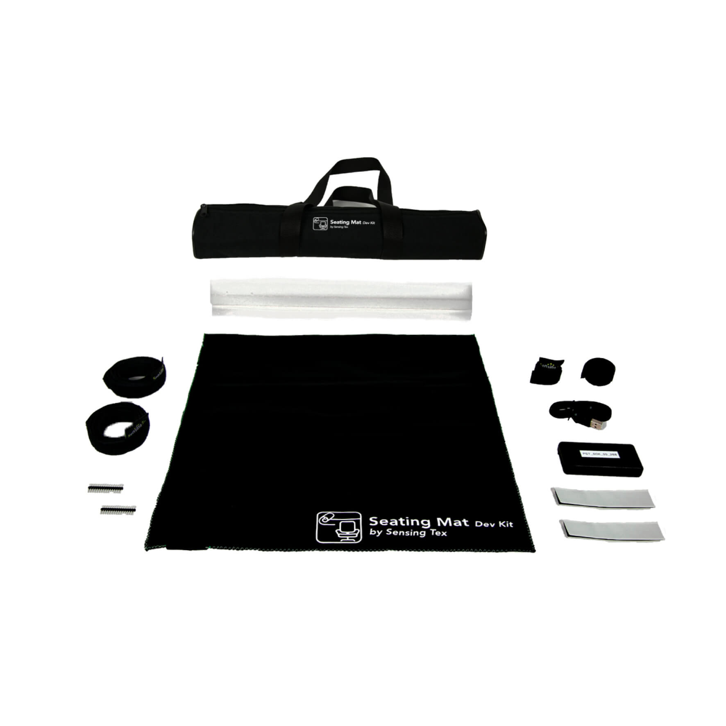




SYSTEM COMPONENTS
3- The Hardware
1- Mat
2- USB Cable
3- Protective Foam
4- Transportation Bag
4- The Demo Software
Sample Images For Illustration Purposes Only

Slide 5
FITNESS MAT FEATURES
Sensing Mat Features
Overall Area (L x W) [mm] | 604 x 521
Sensing Area (L x W) [mm] | 480 x 480
Number of Sensor Elements | 2304
Matrix Topology [R x C] | 48 x 48
Sensor Element Resolution [mm] | 10
Sensor Element Shape | Round
Sensor Element Size [mm] | 6
Pressure Sensing Features
Linearity Coefficient | 0.99
Accuracy | 10%
Pressure Range | 20-10000 mmHg
Hardware Features
ADC Resolution | 8- 12 bits
Scanning frequency [Hz] | 20-50*
OS & Platforms Compatibility | Windows, Linux, OSX, IoT, Android
Standard Connectivity Hardware | USB Serial
Standard Connectivity Enabled | USB Serial (24/7)
Connector Power | Micro-USB
Built in Battery | No
API | Available API to manage data streaming
Software Features
Demo Software | Windows
Software Support | API & Software Developer Guide Provided & Technical Assistance
*Varies depending on the communication, data compression, and receiving device

Slide 6


CONTACT US
SENSING TEX, SL | info@sensingtex.com
Sensing Tex, SL. Sensing Tex® Registered. 2021 All rights reserved. Confidential and proprietary document.
This document and all information contained herein is the sole property of Sensing Tex, SL. No intellectual property rights are granted by the delivery of this document or the disclosure of its content. This document shall not be reproduced or disclosed to third party without the express written consent of Sensing Tex, SL. This document and its content shall not be used for any purpose other than that for which it is supplied.

Slide 7
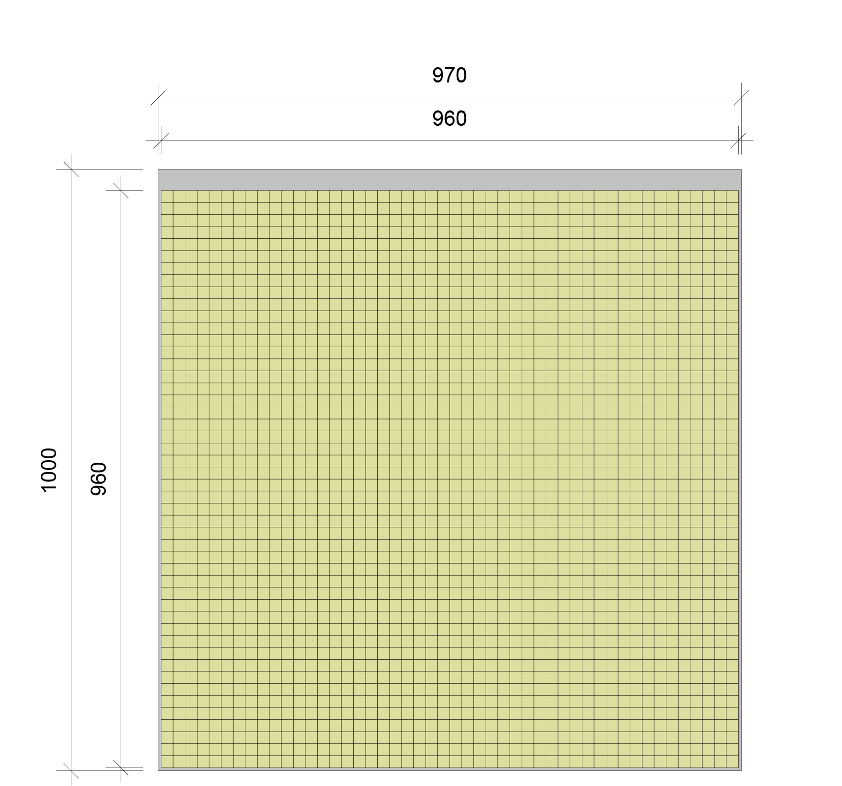
DIAGRAM

